Slide 1
Formal Methods in Software Engineering
Week # 1
Spring 2026
Course Instructor: Haider S. Ahad (Senior Lecturer)

Slide 2
Today’s Agenda
Introductory Session
Course Objectives
Learning Outcomes
Administrative Items
Fundamental Concepts
Questions ?

Slide 3
Office Hours
Office: Cabin 31 – Gym Building
Email: haider.sultan@ucp.edu.pk
Office Hours: Mon & Tue (12 – 3 pm)*
* will be updated during the semester if required

Slide 4
Overall Learning Outcomes
Upon completion of this course, you will be able to:
  Describe the costs and benefits of formal methods
  Construct formal models of sequential software systems
  Implement sequential software systems based on formal models
  Verify attributes of formal models
  Demonstrate formal correctness of simple procedure

Slide 5
Plagiarism Policy
Any form of cheating in assignments, homework problems, quizzes, and exams will result in strict action.
Plagiarism detection tools might be used to determine who has cheated in assignments.
All the parties involved will be awarded Zero in the first instance.
Repeat of the same offense will result in (F) grade.

Slide 6
Tentative Grading Policy *
Class Participation 10%
Quiz 15%
Assignments 15%
Mid Term 20%
Final 40%

Slide 7
Course Sessions
Highly Interactive !!!

Slide 8
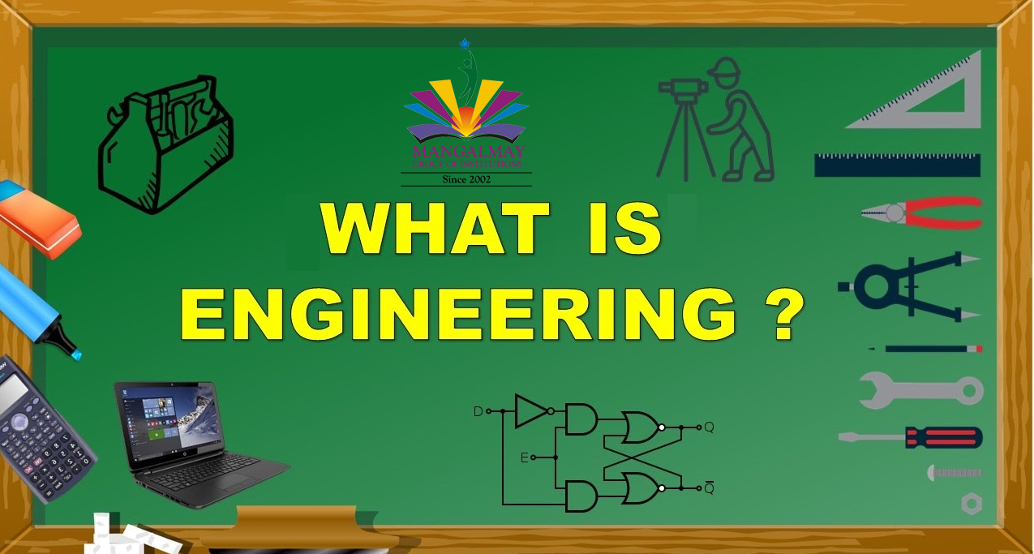

Slide 9
What is Engineering?
The action of working artfully to bring something about.
Engineering is the use of scientific principles to design and build hardware and/or software to fulfill the user need.
Engineers design, build, and maintain various complex systems and structures, from buildings to software.

Slide 10
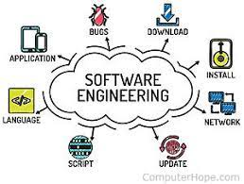

Slide 11
What is Software Engineering?
Software engineering is the application of principles used in the field of engineering, which usually deals with physical systems, to the design, development, testing, deployment and management of software systems.
Software engineering is a systematic engineering approach to software development. A software engineer is a person who applies the principles of software engineering to design, develop, maintain, test, and evaluate computer software.

Slide 12
Software in Modern Life
Software has become critical to modern life
Process Control (oil, gas, water, . . . )
Transportation (air traffic control, . . . )
Health Care (patient monitoring, device control . . . )
Finance (automatic trading, bank security . . . )
Defense (intelligence, weapons control, . . . )
Manufacturing (precision milling, assembly, . . . )

Slide 13

Software systems are embedded everywhere

Slide 14

Software systems are embedded everywhere
Some of them are critical !!!
Failing software costs money and life !!!

Slide 15
Increasing Complexity of Software
The average iPhone app has less than 50,000 lines of code
Google’s entire code base is 2 billion lines of code for all services
Code behind machines e.g., fighter jets, popular video game engines, and even the Large Hadron Collider fall somewhere in between these two extremes
The Control Software to run a US military drone uses 3.5 million lines of code
A Boeing 787 has 6.5 million lines of code behind its avionics and online support systems
Google Chrome (browser) runs on 6.7 million lines of code
Android operating system runs on 12-15 million lines of code
Large Hadron Collider uses 50 million lines of code
https://informationisbeautiful.net/visualizations/million-lines-of-code/

Slide 16
Software Failures –
Pentium Fails Long Division (1993)
Cost: $475 million, corporate credibility
Disaster: Intel’s highly-promoted Pentium chip occasionally made mistakes when dividing floating-point numbers within a specific range. For example, dividing 4195835.0/3145727.0 yielded 1.33374 instead of 1.33382, an error of 0.006%. Although the bug affected few users, it become a public relations nightmare. With an estimated 5 million defective chips in circulation, Intel offered to replace Pentium chips only for consumers who could prove they needed high accuracy. Eventually Intel replaced the chips for anyone who complained.
Cause: The divider in the Pentium floating point unit had a flawed division table, missing about five of a thousand entries and resulting in these rounding errors.

Slide 17
Software Failures –
Cancer Treatment to Die For (2000)
Cost: Eight people dead, 20 critically injured
Disaster: Radiation therapy software by Multi-data Systems International miscalculated the proper dosage, exposing patients to harmful and in some cases fatal levels of radiation. The physicians, who were legally required to double-check the software’s calculations, were indicted for murder.
Cause: The software calculated radiation dosage based on the order in which data was entered, sometimes delivering a double dose of radiation.

Slide 18
Peculiarity of Software Systems
Software faults can have catastrophic consequences:
  Ariane 5, Explosion (data conversion of a too large number)
    https://www.bugsnag.com/blog/bug-day-ariane-5-disaster
  Mars Climate Orbiter, Loss (spurious signals that the lander had landed)
    https://solarsystem.nasa.gov/missions/mars-climate-orbiter/in-depth/
  Mars Sojourner, Pathfinder (unwanted restart)
  Patriot–Scud (rounding error) https://www.iro.umontreal.ca/~mignotte/IFT2425/Disasters.html
  Denver Airport Luggage Handling System
  Pentium-Bug, Division Algorithm (incomplete entries in a look-up-table)
(more at http://www5.in.tum.de/~huckle/bugse.html)

Slide 19
Consequences of Software Failure
Loss of Life
Loss of Money
Software used to control nuclear power plants
Air-traffic control systems
Spacecraft launch vehicle control
Embedded software in cars
Thousands of dollars for each minute of factory down-time
Huge losses of monetary and intellectual investment
Business failures due to buggy software

Slide 20
Real Life Projects in Other Domains
All branches of engineering use mathematics to validate designs before implementation.
For example:
  Civil engineers use mathematics to compute the structural strength of bridges and buildings.
  Aeronautical engineers use mathematics to evaluate different aircraft designs.
However, software systems, although they are among the most complex artifacts we build, are often still built without mathematical modeling.

Slide 21
What are Formal Methods ?
Working Definition: Formal methods are techniques and tools that are based on models of mathematics and mathematical logic and support the description, construction and analysis of hardware and software systems.
Aspects of Formal Methods:
specification: build formal system models
construction: derive correct executable code from formal specifications
verification: prove that models behave as intended

Slide 22
Why to Use Formal Methods?
Short comings of Diagram (informal specification)
  Unstructured
  Had neither syntax nor semantics.
  Impossible to prove the formal correctness of model of the system.
  FM is different form Design.... How?????

Slide 23
Why to Use Formal Methods?
Mathematical modeling and analysis contribute to the overall quality of the final product
Increase confidence in the correctness / robustness / security of a system
Find more flaws and earlier (i.e., during specification and design vs. testing and maintenance)

Slide 24
Benefits of using Formal Methods
Forces developers to think systematically about issues
Improves the quality of specifications and design, even without formal verification
Provides a precise reference to check requirements against
Provides documentation within a team of developers
Provides a basis for reuse via specification matching
Facilitates automatic test case generation

Slide 25
Limitations of Formal Methods
Use formal methods as supplements to quality assurance methods not a replacement for them
Formal methods can increase confidence in a product’s reliability if they are applied skillfully
Useful for consistency checks, but formal methods cannot guarantee the completeness of a specifications
Formal methods must be fully integrated with domain knowledge to achieve positive results

Slide 26
Ten Commandments – I
Choose the appropriate notation
  The specification language used during the initial stages of system development shall have a well-defined formal semantics
  Trade–off between the expressiveness of a specification language and the levels of abstraction that it supports
  Suitability with the system – sequential vs. concurrent systems
  Well established notation with a good user base to ensure successful application in an industrial setting

Slide 27
Ten Commandments – II
Do not over-formalize
  Shouldn’t be used only to satisfy unexplained desire of the company or as a result of peer pressure
  Applying formal methods to all aspects of a system would be both unnecessary and costly e.g., UI design falls within the domain of informal reasoning.
  Consider the level to which formal methods will be employed:
    Formal language aids in making specifications more concise and less ambiguous (Formal Specification)
    Formally specify the system under consideration, proving that certain properties are maintained, and undesirable properties are avoided, and finally translating abstract specification into executable code (Formal Development / Verification)
    With support tools, mechanically check proofs for consistency and well-foundedness (Machine-checked Proofs).

Slide 28
Ten Commandments – III
Estimate costs
  Formal methods are expensive when applied extensively or for the first time
  Inexperience in cost estimation of using formal methods can result in projects over-running the budget
  Formal methods can result in a reduction of errors and an increase in quality of the code produced
  For high integrity systems, cost of deploying formal methods is warranted and the returns are sufficient to justify this.

Slide 29
Ten Commandments – IV
Have a formal methods guru on call
  Majority of successful formal methods projects to date have had access to at least one consultant who is already expert in the use of formal techniques.
  At IBM, formal methods experts spent months on-site training people and resulted in a critical mass of expertise at the company.
  Could also have a pool of mathematicians and software/system engineers who could sufficiently communicate with each other to ensure project success.

Slide 30
Ten Commandments – V
Do not abandon traditional development methods
  It is desirable to integrate formal methods into the design process in a cost-effective manner.
  An alternate to integration is the use of formal methods to review an existing process.
  Cleanroom approach is a technique that could easily incorporate the use of existing formal notations to produce highly reliable software by means of non execution-based program development.
  Combine different formal methods together usefully and effectively e.g., HOL (Higher Order Logic) with Z

Slide 31
Ten Commandments – VI
Document sufficiently
  Formalizing the documentation leads to less ambiguity and thus less likelihood of errors
  In the case of safety-critical systems, timing issues become significant and methods for documenting these are especially important.
  Formal methods provide a precise and unambiguous way of recording the expected and delivered system functionality, and can therefore be used as a powerful documentation aid.
  It is highly recommended to produce an informal specification to explain the formal description

Slide 32
Ten Commandments – VII
Do not compromise quality standards
  Developers look on the application of formal methods as a means of developing correct software.
  On the contrary, formal methods are merely a means of achieving higher integrity systems when applied appropriately.
  There is nothing magical about formal methods, and the organization must ensure that it continues to satisfy its quality standards.

Slide 33
Ten Commandments – VIII
Do not be dogmatic in assuming formal specifications are flawless
  Formal methods are just one of a number of techniques that when applied correctly have been demonstrated to result in systems of the highest integrity, and one should not dismiss other methods entirely.
  Formal methods are no guarantee of correctness; they are applied by humans, who are obviously prone to error

Slide 34
Ten Commandments – IX
Use of formal methods does not eliminate the need to test products
  Dijkstra highlighted that testing can demonstrate the presence of ‘bugs’, it cannot demonstrate their absence
  Formal methods allow us to propose properties of the system and to demonstrate that they hold
  Formal methods allow us to examine system behavior and to convince ourselves that all possibilities have been anticipated
  Formal methods enable us to prove the conformance of an implementation with its specification

Slide 35
Ten Commandments – X
Reuse is still important
  Over the long term, the only rational way to reduce software costs and increase software quality is through reuse.
  Formal methods do not change this reality.
  In fact, it may be that formal methods are an appropriate approach when components for reuse libraries are to be created.

Slide 36
Myths of Formal Methods – I
Myth 1: Formal Methods can guarantee that software is perfect
Myth 2: Formal Methods are all about proving program correctness
Myth 3: Formal Methods are only useful for safety-critical systems
Myth 4: Formal Methods require highly trained mathematicians
Myth 5: Formal Methods increase the cost of development
Myth 6: Formal Methods are unacceptable to users
Myth 7: Formal Methods are not used on real, large-scale software

Slide 37
Myths of Formal Methods – II
Myth 8: Formal Methods delay the development process
Myth 9: Formal Methods lack tools
Myth 10: Formal Methods replace traditional engineering design methods
Myth 11: Formal Methods only apply to software (and not to hardware)
Myth 12: Formal Methods are unnecessary
Myth 13: Formal Methods are not supported
Myth 14: Formal Methods people always use formal methods

Slide 38
Formal methods vs Testing
Traditional system design has used extensive testing to verify behavior, but testing is capable of only finite conclusions. Dijkstra and others have demonstrated that tests can only show the situations where a system won't fail, but cannot say anything about the behavior of the system outside of the testing scenarios. In contrast, once a theorem is proven true it remains true.
It is very important to note that formal verification does not remove the need for testing. Formal verification cannot fix bad assumptions in the design, but it can help identify errors in reasoning which would otherwise be left unverified. In several cases, engineers have reported finding flaws in systems once they reviewed their designs formally.

Slide 39
Formal Specification Languages
A formal specification language consists of
    syntax (the notation)
    semantics (the meaning)
    satisfies (relation defining which objects satisfy which notations)
A formal specification defines
    syntax (signature of the mapping)
    semantics (meaning of the mapping)
    exceptions (undefined/erroneous mappings)

Slide 40
Formal Specifications are not yet widely used
Reasons
    emerging technology with unclear payoff
    little experience
    not especially user friendly
Excuses
    high learning curve
    mathematical sophistication required
    techniques not widely applicable
    ignorance of advances

Slide 41
Formal Specification in Software Development
Formal specifications ground the software development process in the well-defined basis of computer science
Emphasis switches from customer to developer
Formal specification expressed in language whose syntax and semantics are formally defined
    hierarchical decomposition
    mathematical foundation
    graphical presentation
    accompanied by informal description
I

Slide 42
Goals and Objectives
Requirements Specification
    clarify customer's requirements
  reveal ambiguity, inconsistency, incompleteness
System/Software Design
  decomposition structural specifications of component relations and behavioural specification of components
  refinement demonstrating that next level of abstraction satisfies higher level
Verification
  proving a specificand (implementation) satisfies its specification
Validation
  testing and debugging
Documentation
  communication between specifier, implementor, customer, clients

Slide 43
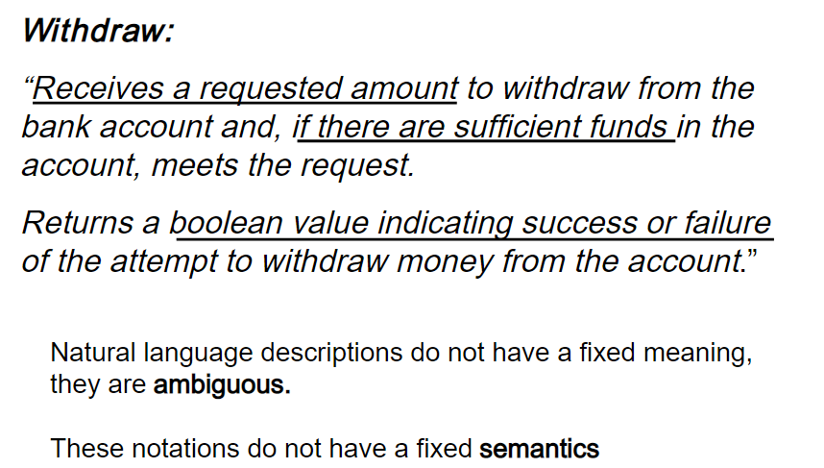
Weakness of Natural Language specification

Slide 44
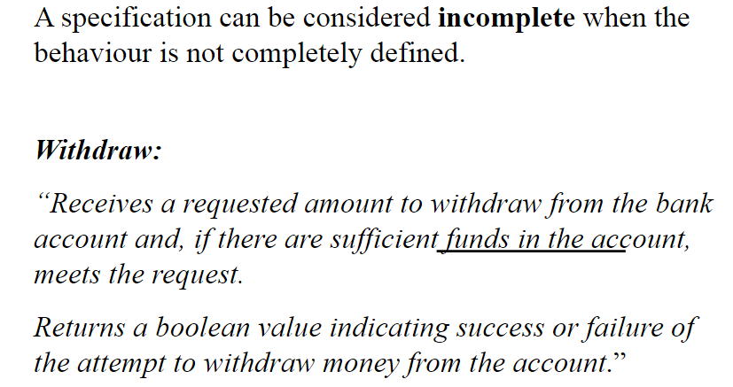
Incomplete Specification

Slide 45
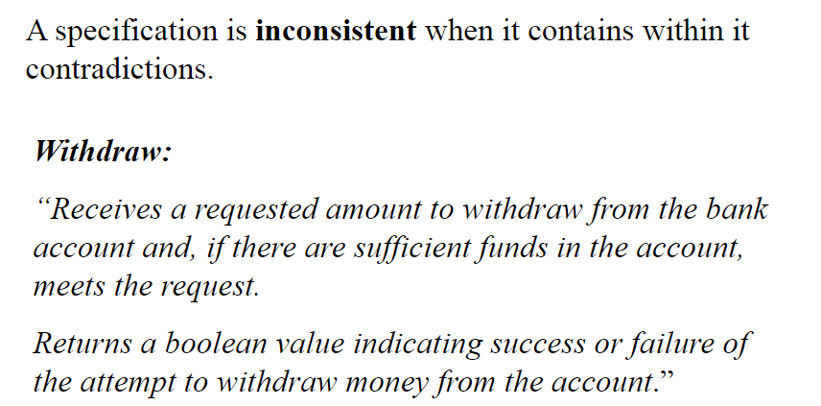
Inconsistent Specification

Slide 46
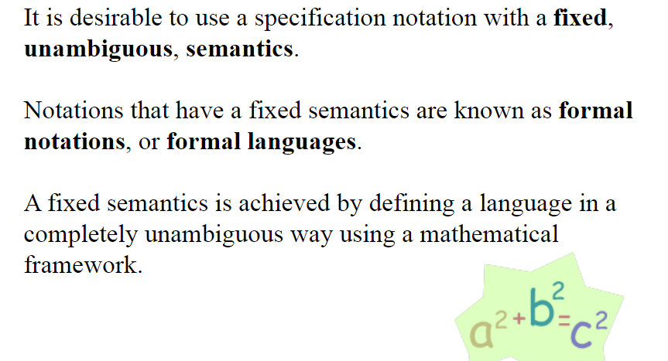
Formal Languages

Slide 47
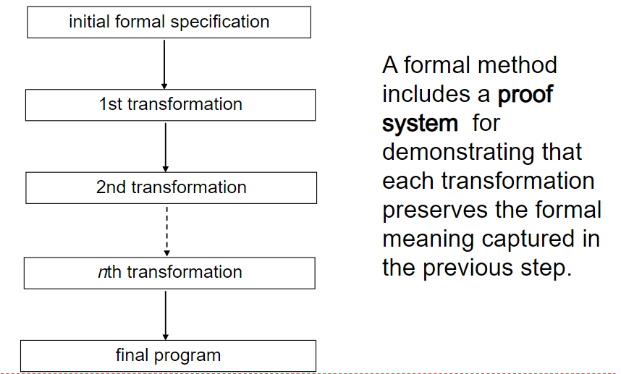
Formal Methods

Slide 48
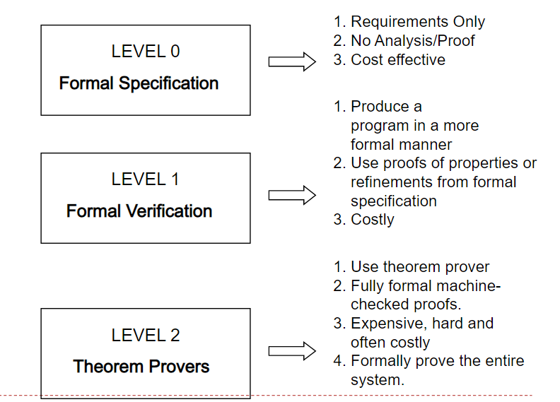
Three Levels of Formal Methods

Slide 49
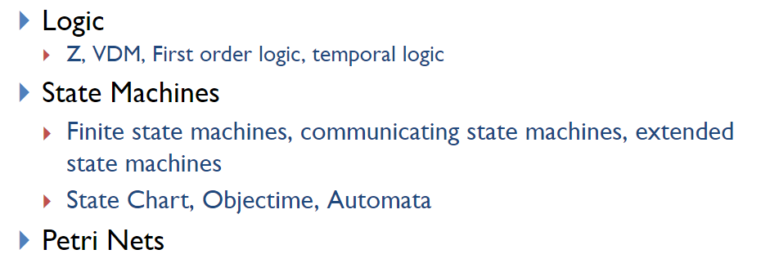
Formal Specification Methods

Slide 50
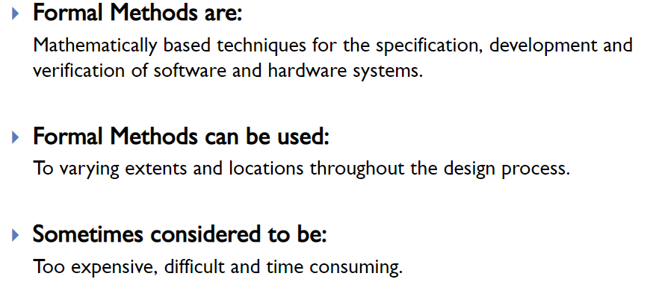
Conclusion

